Slide 1
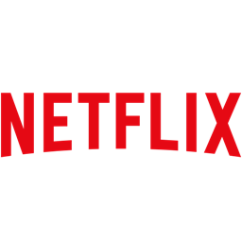
Netflix Content Strategy - What Should We Produce Next?
Director | Aligned Genres | No. of Movies
Toshiya Shinohara | Action & Adventure, Anime Features, International Movies | 4
Masahiko Murata | Action & Adventure, Anime Features, International Movies | 3
Hajime Kamegaki | Action & Adventure, Anime Features, International Movies | 2
Delhiprasad Deenadayalan | Comedies, Dramas, International Movies | 2
GENRE TRENDS
■ Action & Adventure, Anime Features, International Movies
■ Children & Family Movies
■ Children & Family Movies, Comedies
■ Documentaries
■ Dramas, Independent Movies, International Movies
■ Others
KEY INSIGHT
Our analysis identifies Toshiya Shinohara as a high-frequency director aligned with top-performing genres.
We recommend greenlighting a Netflix original in Action & Adventure, Anime Features, and International
Movies under his direction.”

